Slide 1
The Battle of Neighborhood II
Madrid Rent Apartment neighborhood report

Slide 2
1. Introduction
Madrid is the capital of Spain and the largest municipality in both the Community of Madrid and Spain as a whole. The city has almost 3.3 million inhabitants and a metropolitan area population of approximately 6.5 million. It is the third-largest city in the European Union (EU), smaller than only London and Berlin, and its monocentric metropolitan area is the third-largest in the EU, smaller only than those of London and Paris.The municipality covers 604.3 km2 (233.3 sq mi). The Madrid urban agglomeration has the third-largest GDP in the European Union and its influence in politics, education, entertainment, environment, media, fashion, science, culture, and the arts all contribute to its status as one of the world's major global cities. Madrid is home to two world-famous football clubs, Real Madrid and Atlético Madrid. Due to its economic output, high standard of living, and market size, Madrid is considered the leading economic hub of the Iberian Peninsula and of Southern Europe

Slide 3
2. Objectives
In this presentation, we will study in details the area classification using Foursquare data and machine learning segmentation and clustering. The aim of this report is to segment areas of Madrid based on the most common places captured from Foursquare.

Slide 4
3. Data
The data acquired from:
URLs: https://datos.madrid.es/sites/v/index.jsp?vgnextoid=374512b9ace9f310VgnVCM100000171f5a0aRCRD&buscar=true&Texto=&Sector=vivienda&Formato=&Periodicidad=&orderByCombo=CONTENT_INSTANCE_NAME_DECODE
The data adquired from URL, was restructured for easier manipulation and reading into files:
MADRID_RENT_APARMENTS.csv

Slide 5
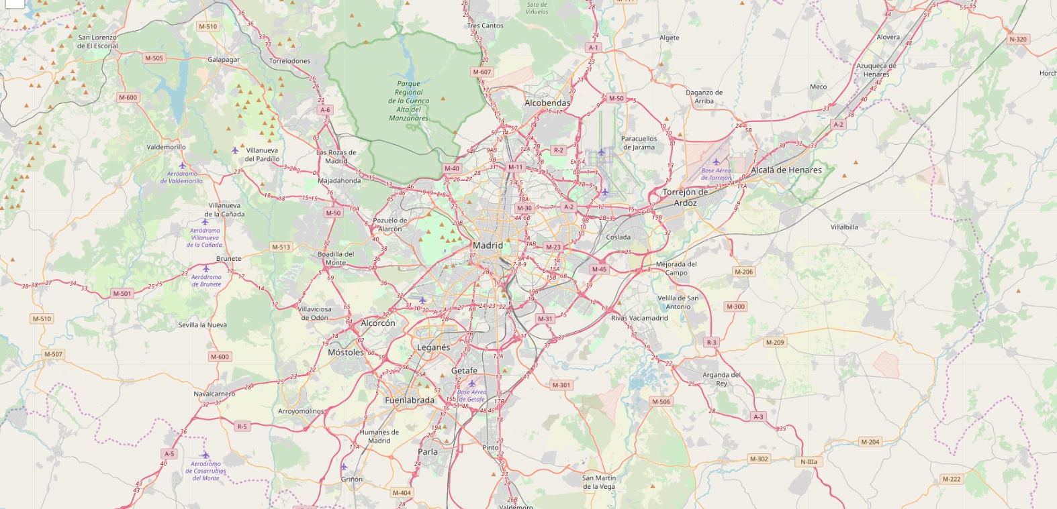
4. Madrid: Analyzing and visualization 4.1 Madrid: Map
Coordinates of Madrid: 40.4167047, -3.7035825

Slide 6
4. Madrid: Analyzing and visualization 4.2 Madrid: Districts & Neighborhoods
Madrid has 21 districts and 106 neighborhoods
 | District | Neighborhood
1 | ARGANZUELA | IMPERIAL, ACACIAS, PALOS DE MOGUER, DELICIAS, ...
2 | BARAJAS | TIMON, ALAMEDA DE OSUNA, TIMON
3 | CARABANCHEL | COMILLAS, SAN ISIDRO, OPAÑEL, ABRANTES, PUERTA...
4 | CENTRO | JUSTICIA, UNIVERSIDAD, PALACIO, EMBAJADORES, C...
5 | CHAMARTIN | PROSPERIDAD, CIUDAD JARDIN, EL VISO, NUEVA ESPAÑA
6 | CHAMBERI | RIOS ROSAS, VALLEHERMOSO, TRAFALGAR, ARAPILES
7 | CIUDAD LINEAL | PUEBLO NUEVO, VENTAS, SAN PASCUAL, QUINTANA, C...
8 | FUENCARRAL-EL PARDO | LA PAZ, EL PILAR, VALVERDE, MIRASIERRA, PEÑA G...
9 | HORTALEZA | HELLIN, PINAR DEL REY, APOSTOL SANTIAGO, CANIL...
10 | LATINA | LUCERO, PUERTA DEL ANGEL, LAS AGUILAS, CAMPAME...
11 | MONCLOA-ARAVACA | CASA DE CAMPO, ARGUELLES, ARAVACA, VALDEZARZA
12 | MORATALAZ | VINATEROS, PAVONES, MEDIA LEGUA, MARROQUINA, P...
13 | PUENTE DE VALLECAS | PALOMERAS SURESTE, PALOMERAS BAJAS, PORTAZGO, ...
14 | RETIRO | ESTRELLA, PACIFICO, ADELFAS, NIÑO JESUS, IBIZA
15 | SALAMANCA | CASTELLANA, FUENTE DEL BERRO, GUINDALERA, RECO...
16 | SAN BLAS-CANILLEJAS | HELLIN, REJAS, ARCOS, EL SALVADOR, SIMANCAS
17 | TETUAN | CUATRO CAMINOS, CASTILLEJOS, ALMENARA, BELLAS ...
18 | USERA | MOSCARDO, ALMENDRALES, ZOFIO, ORCASUR, ORCASIT...
19 | VICALVARO | CASCO H.VICALVARO, AMBROZ
20 | VILLA DE VALLECAS | SANTA EUGENIA, CASCO H.VALLECAS, SANTA EUGENIA...
21 | VILLAVERDE | LOS ROSALES, BUTARQUE, SAN CRISTOBAL, SAN ANDR..

Slide 7
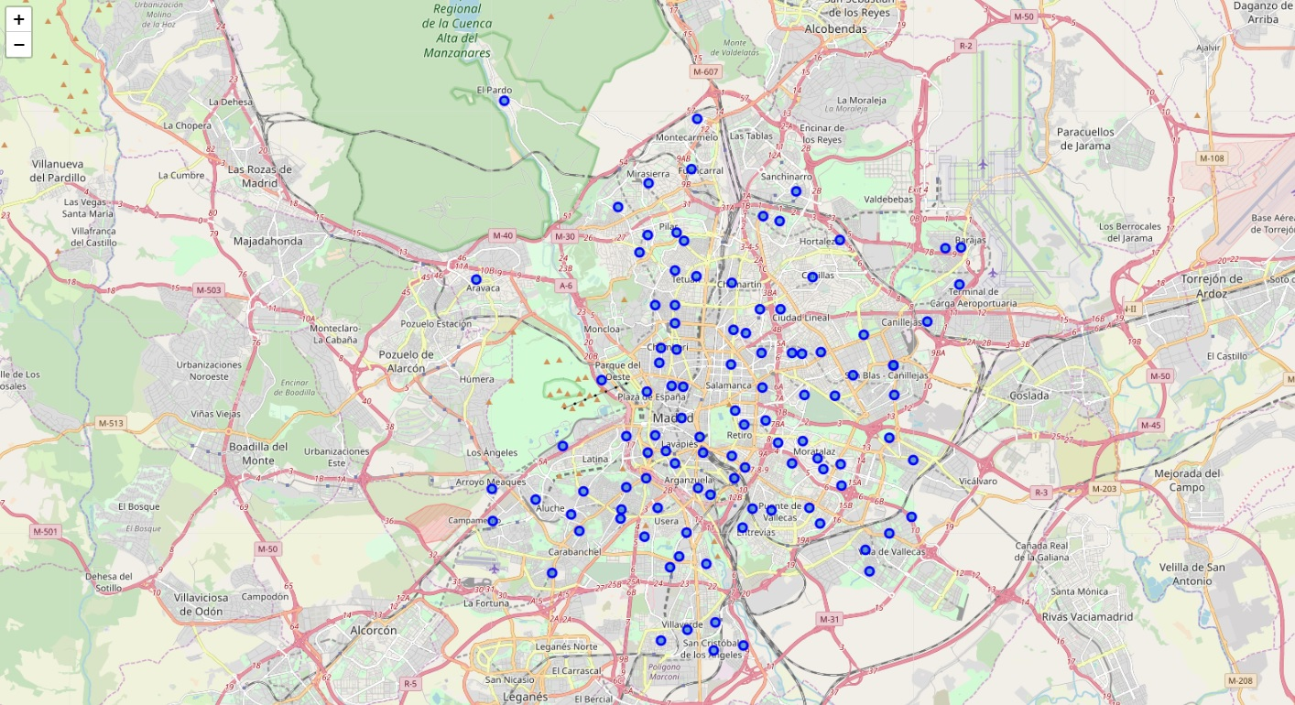
4. Madrid: Analyzing and visualization 4.2 Madrid: Districts & Neighborhoods Map

Slide 8
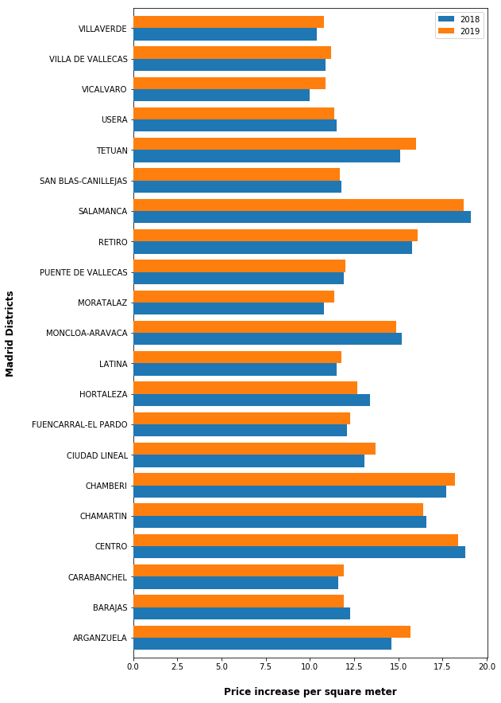
4.4 Madrid: Rent apartment price increase per square meter between 2018-2019

Slide 9
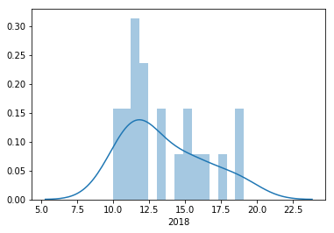
4.5 Madrid: Rent apartment price increase per square meter: 2018

Slide 10
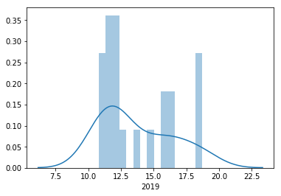
4.6 Madrid: Rent apartment price increase per square meter: 2019

Slide 11
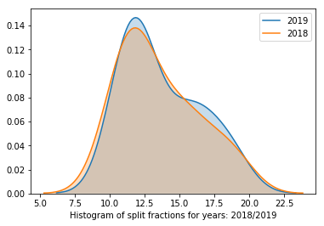
4.7 Madrid: Rent apartment price increase per square meter between 2018-2019

Slide 12
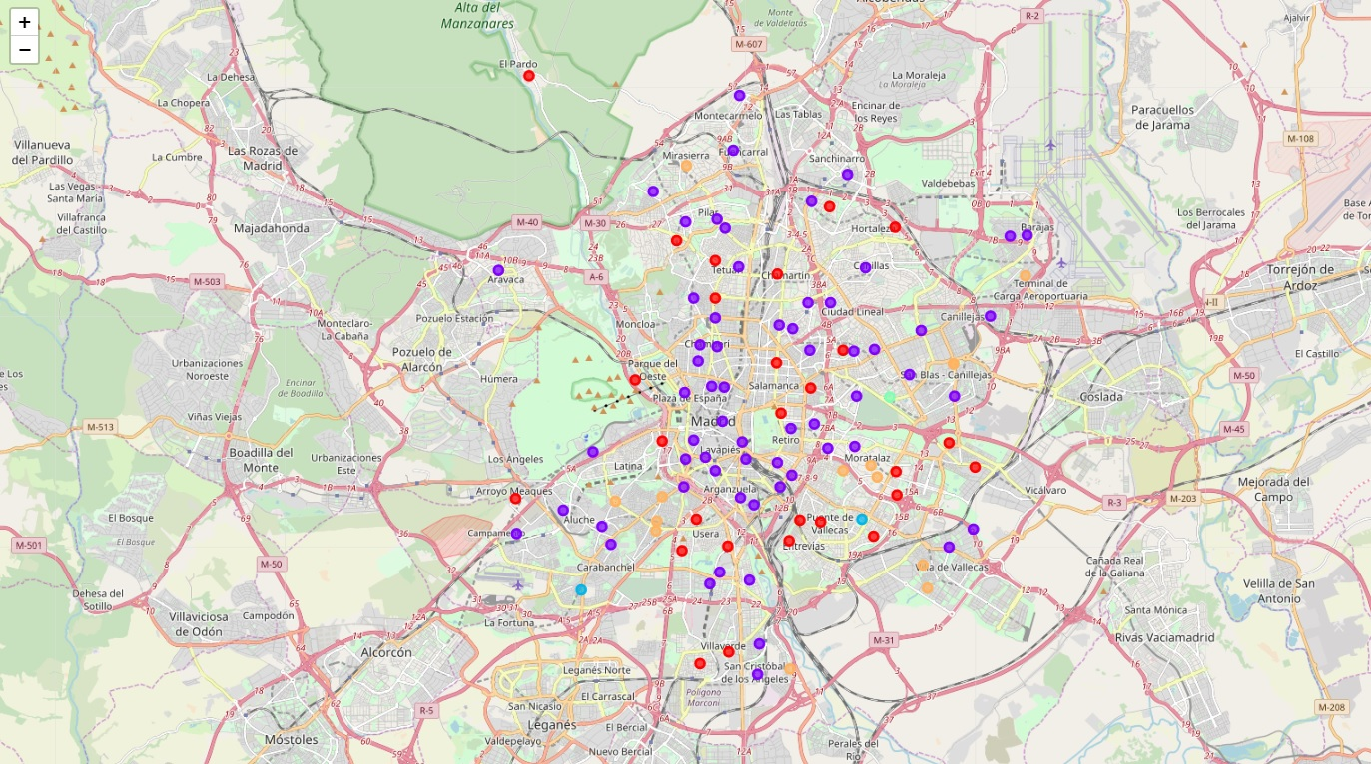
4.8 Madrid: Segmentation & Clustering

Slide 13
4.8 Madrid: Segmentation & Clustering
Madrid: Cluster 0
Cluster | District | 1st Most Common Venue
0 | CHAMARTIN | Spanish Restaurant
0 | CIUDAD LINEAL | Spanish Restaurant
0 | FUENCARRAL-EL PARDO | Spanish Restaurant
0 | HORTALEZA | Spanish Restaurant
0 | HORTALEZA | Spanish Restaurant
0 | LATINA | Spanish Restaurant
0 | LATINA | Spanish Restaurant
0 | MONCLOA-ARAVACA | Food
0 | MONCLOA-ARAVACA | Spanish Restaurant
0 | MORATALAZ | Athletics & Sports
0 | MORATALAZ | Athletics & Sports
0 | PUENTE DE VALLECAS | Chinese Restaurant
0 | PUENTE DE VALLECAS | Spanish Restaurant
0 | PUENTE DE VALLECAS | Spanish Restaurant
0 | PUENTE DE VALLECAS | Pizza Place
0 | RETIRO | Spanish Restaurant
0 | SALAMANCA | Spanish Restaurant
0 | SALAMANCA | Spanish Restaurant
0 | TETUAN | Spanish Restaurant
0 | TETUAN | Spanish Restaurant
0 | USERA | Grocery Store
0 | USERA | Spanish Restaurant
0 | USERA | Park
0 | VICALVARO | Grocery Store
0 | VICALVARO | Spanish Restaurant
0 | VILLAVERDE | Wine Shop
0 | VILLAVERDE | Spanish Restaurant

Slide 14
4.8 Madrid: Segmentation & Clustering
Madrid: Cluster 1
Cluster | District | 1st Most Common Venue
1 | ARGANZUELA | Spanish Restaurant
1 | ARGANZUELA | Spanish Restaurant
1 | ARGANZUELA | Spanish Restaurant
1 | ARGANZUELA | Spanish Restaurant
1 | ARGANZUELA | Café
1 | ARGANZUELA | Bar
1 | BARAJAS | Hotel
1 | BARAJAS | Hotel
1 | CARABANCHEL | Spanish Restaurant
1 | CARABANCHEL | Bakery
1 | CARABANCHEL | Pizza Place
1 | CENTRO | Restaurant
1 | CENTRO | Bar
1 | CENTRO | Tapas Restaurant
1 | CENTRO | Bar
1 | CENTRO | Spanish Restaurant
1 | CHAMARTIN | Spanish Restaurant
1 | CHAMARTIN | Coffee Shop
1 | CHAMARTIN | Spanish Restaurant
1 | CHAMBERI | Spanish Restaurant
1 | CHAMBERI | Bar
1 | CHAMBERI | Tapas Restaurant
1 | CHAMBERI | Spanish Restaurant
1 | CIUDAD LINEAL | Soccer Field
1 | CIUDAD LINEAL | Tapas Restaurant
1 | CIUDAD LINEAL | Spanish Restaurant
1 | CIUDAD LINEAL | Gym / Fitness Center
1 | CIUDAD LINEAL | Bar
1 | FUENCARRAL-EL PARDO | Restaurant
1 | FUENCARRAL-EL PARDO | Pizza Place
1 | FUENCARRAL-EL PARDO | Grocery Store
1 | HORTALEZA | Rock Club
1 | HORTALEZA | Park
1 | LATINA | Theme Park Ride / Attraction
1 | LATINA | Convenience Store
1 | LATINA | Italian Restaurant
1 | MONCLOA-ARAVACA | Hotel
1 | MONCLOA-ARAVACA | Restaurant
1 | MORATALAZ | Restaurant
1 | MORATALAZ | Coffee Shop
1 | RETIRO | Cocktail Bar
1 | RETIRO | Spanish Restaurant
1 | RETIRO | Bar
1 | RETIRO | Spanish Restaurant
1 | SALAMANCA | Hotel
1 | SALAMANCA | Spanish Restaurant
1 | SAN BLAS-CANILLEJAS | Bar
1 | SAN BLAS-CANILLEJAS | Pizza Place
1 | SAN BLAS-CANILLEJAS | Hotel
1 | SAN BLAS-CANILLEJAS | Café
1 | TETUAN | Spanish Restaurant
1 | TETUAN | Bar
1 | TETUAN | Spanish Restaurant
1 | USERA | Coffee Shop
1 | USERA | Market
1 | USERA | Grocery Store
1 | VILLA DE VALLECAS | Farmers Market
1 | VILLA DE VALLECAS | Farmers Market
1 | VILLAVERDE | Metro Station
1 | VILLAVERDE | Breakfast Spot

Slide 15
4.8 Madrid: Segmentation & Clustering
Madrid: Cluster 2
Cluster | District | 1st Most Common Venue
2 | CARABANCHEL | Bar
2 | PUENTE DE VALLECAS | Bar

Slide 16
4.8 Madrid: Segmentation & Clustering
Madrid: Cluster 3
Cluster | District | 1st Most Common Venue
3 | CIUDAD LINEAL | Park

Slide 17
4.8 Madrid: Segmentation & Clustering
Madrid: Cluster 4
Cluster | District | 1st Most Common Venue
4 | BARAJAS | Hotel
4 | CARABANCHEL | Coffee Shop
4 | CARABANCHEL | Plaza
4 | CARABANCHEL | Brazilian Restaurant
4 | FUENCARRAL-EL PARDO | Sports Club
4 | HORTALEZA | Fast Food Restaurant
4 | LATINA | Grocery Store
4 | MORATALAZ | Playground
4 | MORATALAZ | Playground
4 | PUENTE DE VALLECAS | Mediterranean Restaurant
4 | SAN BLAS-CANILLEJAS | Fast Food Restaurant
4 | VILLA DE VALLECAS | Grocery Store
4 | VILLA DE VALLECAS | Grocery Store
4 | VILLAVERDE | Sports Bar

Slide 18
5. Results
Madrid:
Districts: 21
Neighborhoods: 106
Uniques categories: 242
1st. Most Common Venues:
- Cluster 0: Spanish Restaurant
- Cluster 1: Spanish Restaurant
- Cluster 2: Spanish Restaurant
- Cluster 3: Grocery Store
- Cluster 4: Bar
Madrid has the largest number of restaurants percapita by districts and neighborhoods
Price increase per square meter/year
The increase in the rental price is determined by:
1. The proximity of the district / neighborhood to the downtown area.
2. The number of venues in each district/neighborhood

Slide 19
6. Discussion
a. Are the results obtained sufficient to identify and distinguish different districts and describe the correlation of the most common places registered in Foursquare?
b. In fact, similar cities may or may not have similar places. Then, an additional step in this classification would be to find a method to extract these common places and integrate spatial correlations between different neighborhoods or districts.
c. However, the proposed segmentation and clustering is a first approach towards a quantitative and systematic comparison of the different districts/neighborhoods

Slide 20
7. Conclusion
We can captured data of common places all around the world using Foursquare API
We can differentiate, with the results obtained, the districts and neighborhoods of Madrid and the factors that influence the increase in rental price apartment.
c. More studies are needed to relate the acquired data and then observe them with more significant and objective results.

